Slide 1
WhiteHat Data Fellowship
Webinar Series: Git & GitHub

Slide 2
Introduction
Notes:
Ask apprentice to explain what customer lifecycle is…

Slide 3
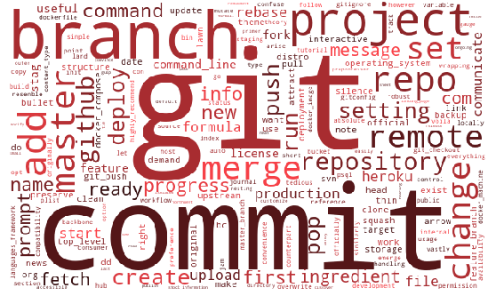

Slide 4
Version Control systems maintain changes recorded in a file or set of files (project) over a period of time - versions

Slide 5






What kind of version control system do you use at work?

Slide 6
Git vs Github
Notes:
Ask apprentice to explain what customer lifecycle is…

Slide 7
Git and GitHub are both forms of version control
Git is installed on your device and used locally
GitHub is online and you can use it remotely
Combined - extremely useful & powerful tool!
GitHub and Git use common terminology but:
You can use GitHub without needing to know Git
You can use Git without needing to use GitHub

Slide 8
Terminology
Notes:
Ask apprentice to explain what customer lifecycle is…

Slide 9
Git & GitHub Terminology
Repository
A data repository is a place where data is:
Stored
Maintained
Repositories can contain any file type your project needs

Slide 10
Git & GitHub Terminology
Add - After changing and saving your file(s) you add the file(s) to the staging area
Commit - you then commit the file(s) from the staging area to your local repo/head
This 2-stage process allows you to filter which files to commit and adds an extra layer of security

Slide 11
Git & GitHub Terminology
Branch
Allows you to make edits, changes and experiment without altering the project
By default, each repo has one definitive branch and this is called the master branch
When you create a branch, you’re making a copy of the master as it was at that point in time

Slide 12
Git & GitHub Terminology
Push - The process of putting your local repo in a remote repo
Pull (Pull Request) - The process of submitting your contribution to an open source development project
Fork - The process of making a remote personal copy of a remote repo
Clone - The process of making a local personal copy of a remote repo

Slide 13
Workflow
Notes:
Ask apprentice to explain what customer lifecycle is…

Slide 14

Your Local Repo
Your GitHub (Remote) Repo
Upstream

Slide 15
Your Local Repo
Your GitHub (Remote) Repo
Downstream

Slide 16
Local Workflow
Notes:
Ask apprentice to explain what customer lifecycle is…

Slide 17

Local/Private Repo
User Account 1: Local Repo
User Account 2: Local Repo
Notes:
You can completely bypass GitHub if you have a shared drive with other users, such as those on a private network within an organisation

Slide 18
The three ‘trees’ of Git
Workspace/Working Directory
Staging Index
Head
Your local Repository
Workspace
Staging
Head

Slide 19
Your Workspace
This is your sandbox - a place you can make changes before committing them to the project
This directory unpacks the repo contents into human readable form
Easy to access and edit files
Workspace
Staging
Head

Slide 20
The Staging Index
Stores the content you have added from your workspace
This is done using the git add command
This is your proposed new content that you want to ‘commit’
Workspace
Staging
Head

Slide 21
Head
A snapshot of your latest ‘commit’
Done using the git commit command
You would push the contents of this tree to your remote repo
Workspace
Staging
Head

Slide 22
Workspace
Staging
Head
Remote Repo
git add
git commit
git push
git pull/clone

Slide 23
Remote/Local Workflow
Notes:
Ask apprentice to explain what customer lifecycle is…

Slide 24


Remote Repo
Your Local Repo
Your GitHub (Remote) Repo
Another GitHub (Remote) Repo
Pull
Fork
Pull
Push
Pull Request
Clone/Pull

Slide 25
Push
This ‘pushes’ your code from your local repo to your remote one (e.g. GitHub account)
Push
Your GitHub (Remote) Repo
Local

Slide 26
Pull Request
A request to have your code pulled into another project
Requires:
Owner’s knowledge of your changes
Owner’s permission to incorporate your code
Pull Request
Your GitHub (Remote) Repo
Another GitHub (Remote) Repo

Slide 27
Pull Request *Aside
You may think you’d want to ‘push’ your changes to another repo, right?
GitHub sees you as the object not the subject and that you are requesting the owner pulls in the changes from your repository

Slide 28
Your GitHub (Remote) Repo
Another GitHub (Remote) Repo
Pull
Copies material from remote repo into your local repo
Pull
Pull
Pull
Your Local Repo

Slide 29
Fork
A replica of another repo in your account
Your GitHub (Remote) Repo
Another GitHub (Remote) Repo
Fork

Slide 30
Your GitHub (Remote) Repo
Another GitHub (Remote) Repo
Clone
Copies material from remote repo into your local repo
Clone
Clone
Your Local Repo

Slide 31
Demo 1 - Local Repo Project
Notes:
Ask apprentice to explain what customer lifecycle is…

Slide 32
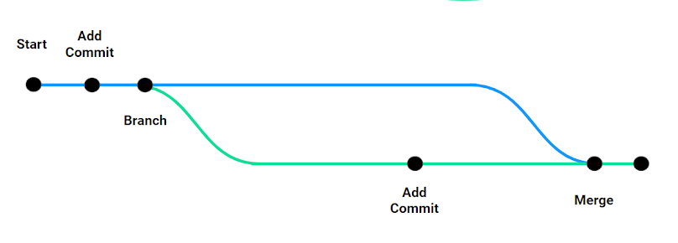
Demo 1 - Local Repo Project
In this demo, we are going to create a project (single text file)
Use common Git commands to store and access different versions of this file

Slide 33
Start
Add
Commit
Branch
Add Commit
Merge
Main Project (Master)
Your version of Project (Branch)

Slide 34
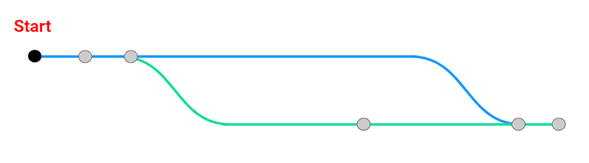
Open Git Bash (Windows), Bash Terminal (Macs)
Make sure you are in your home directory (e.g. /c/Users/UserName)
type: cd ~
Not sure where this is? Type the following and make a note!
type: pwd

Slide 35
Make a new directory (folder)
type: mkdir [directory_name]
Navigate into your new directory
type: cd filepath/[directory_name]/
Initialise a new local Git repository
type: git init
Create a new file using the bash command
touch [filename.ext]
Open the file and add some text
When finished, Save As (ctrl+shft+s)

Slide 36
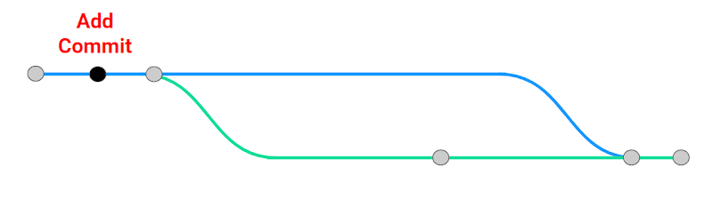
Add your version to your staging index
git add [filename.ext]
Check Status
git status
Commit your version
git commit -m “commit message”
Check Status
git status
Check your log
git log

Slide 37
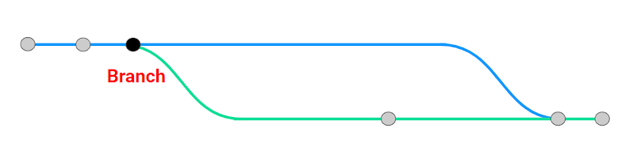
Create a new branch
git branch [branch_name]
Move to new branch (current branch: master)
git checkout [branch_name]
See a list of branches (* next to the one you’re in)
git branch
Edit the file
When finished, Save As (ctrl+shft+s)

Slide 38
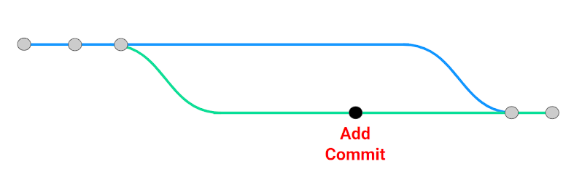
Add your version to your staging index
git add [filename.ext]
Check Status
git status
Commit your version
git commit -m “commit message”
Check Status
git status
Check your log
git log

Slide 39

Go back to your master (you can only merge from here)
git checkout master
Merge your new branch with the master
git merge [branch_name]
You can only merge from the master
Check your log
git log
(You will see the master has the old branch commits)

Slide 40
Demo 2 - Push
Notes:
Ask apprentice to explain what customer lifecycle is…

Slide 41
Demo 2 - Push
In this demo, we are going to push our file upstream to our remote repo (https://github.com/[yourUserName])
Push
Your GitHub (Remote) Repo
Local

Slide 42
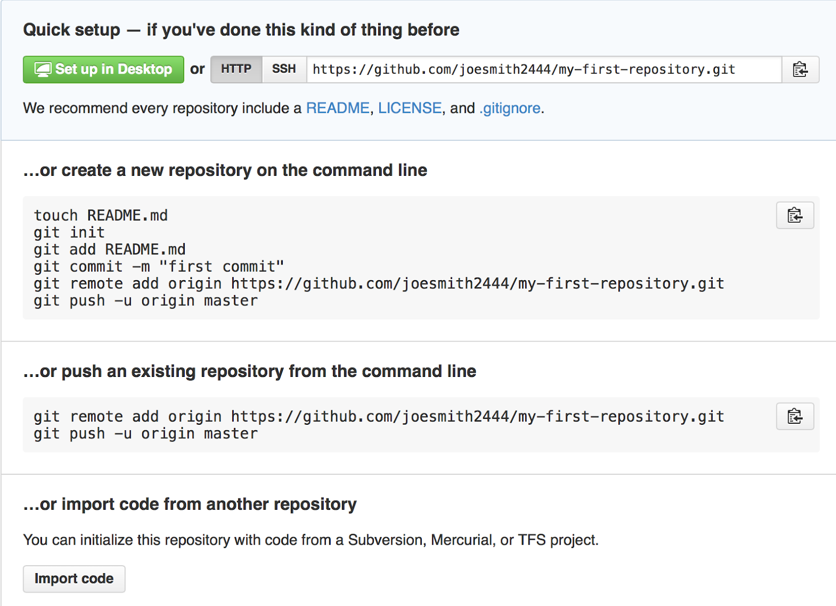
Connect to GitHub (https://github.com/)
Open a new repo
Name it
Add description (optional)
DO NOT TICK THE README BOX
Click create repository
Review new page

Slide 43
Point your local repo to the remote repo
git remote add origin [GitHub repo name]
Push your code from local to remote repo
git push -u origin master

Slide 44
Additional Commands
Pull latest changes in remote repo to local repo
git pull origin master
Clone an existing repo into your computer
git clone [repo_name]

Slide 45
Demo 3 - Pull Request
Notes:
Ask apprentice to explain what customer lifecycle is…

Slide 46

Demo 3 - Pull Request
In this demo, we will pull a version of the file from our remote repo to our local repo

Slide 47
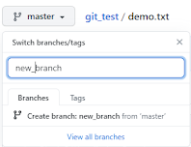
1. Create a new branch
Click on branch dropdown list
Write new branch name
Press return
You have two identical branches... For now

Slide 48
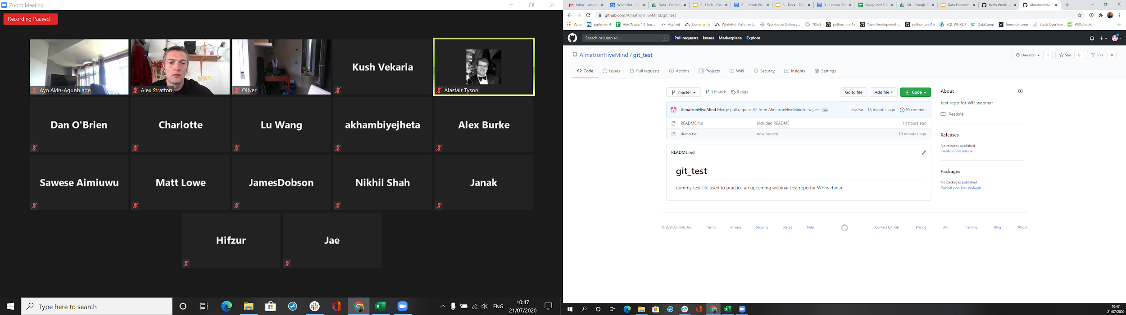
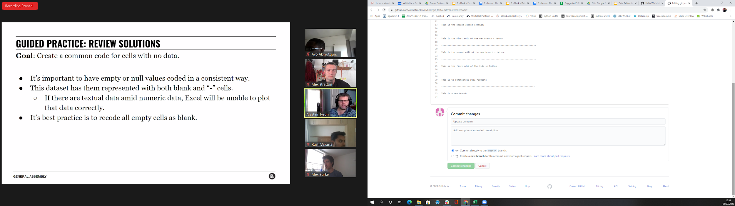
2. Make & Commit Changes
Click on the .txt file
Click on the edit icon
Write something in the .txt file
Write a commit message
Click “commit changes”

Slide 49
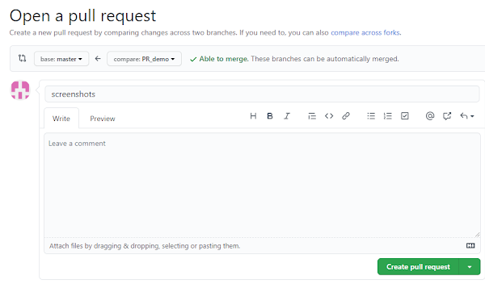
3. Open a Pull Request
Click on “pull request”
Compare your new file to old file
Give your request a name and a comment
When satisfied with the changes, press the “Create Pull Request”
Give it a title and description
Click “Create Pull Request” again

Slide 50
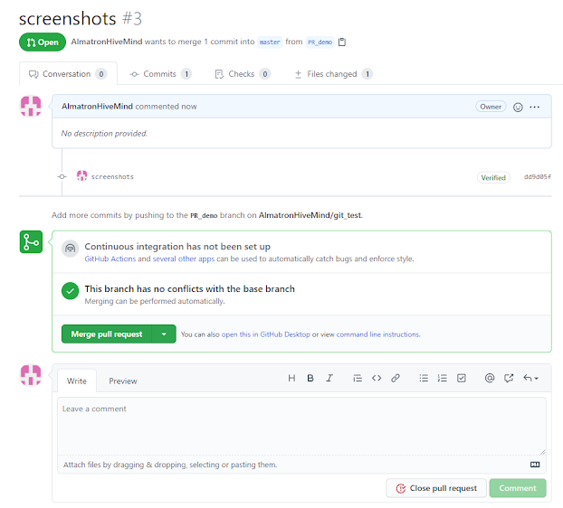
3. Merge
Click on the “Merge Pull Request” to merge the changes with the master
Click “Confirm Merge”
Delete the branch (optional but recommended)

Slide 51
Demo 4 - Fork & Clone
Notes:
Ask apprentice to explain what customer lifecycle is…

Slide 52
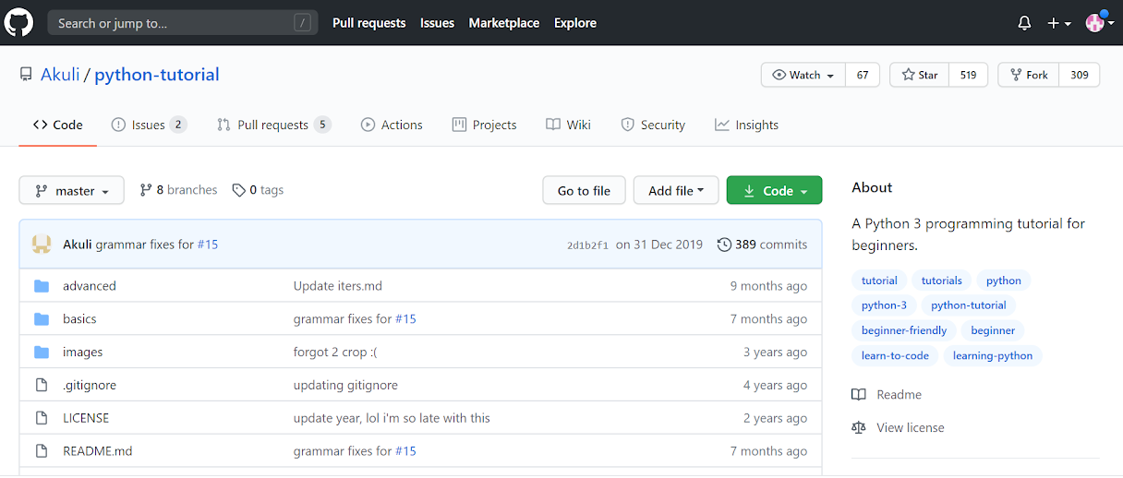
Demo 4 - Fork
Fork

Slide 53
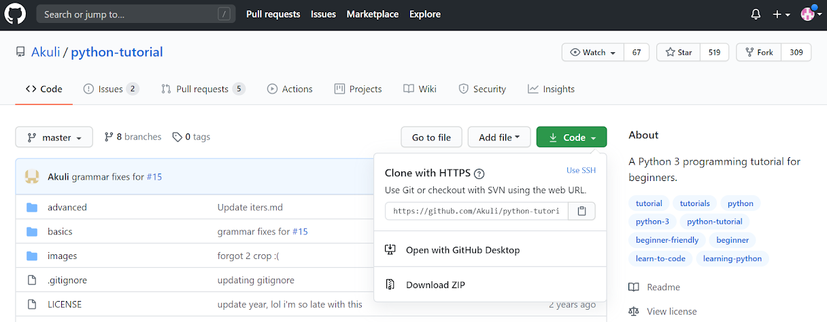
Clone

Slide 54
Version Control Best Practice
Notes:
Ask apprentice to explain what customer lifecycle is…

Slide 55
Commit related changes
Fixing two separate bugs should produce two separate commits
Commit often
Avoids merge conflicts and writing redundant code
Test before you commit
Very important in collaboration!
Write clear and relevant commit messages
What was the motivation for the commit?
How does it differ from previous versions?

Slide 56
Resources
Notes:
Ask apprentice to explain what customer lifecycle is…

Slide 57
Resources
Intro to Command Line - https://www.git-tower.com/learn/git/ebook/en/command-line/appendix/command-line-101
An intro to Git - https://www.freecodecamp.org/news/what-is-git-and-how-to-use-it-c341b049ae61/
Youtube GitHub Video (Colt Steele) - https://www.youtube.com/watch?v=nhNq2kIvi9s&t=819s
Youtube Git Video (Colt Steele) - https://www.youtube.com/watch?v=USjZcfj8yxE&t=238s
Bash Cheatsheet - https://www.educative.io/blog/bash-shell-command-cheat-sheet
Bash Commands - https://hackernoon.com/top-10-bash-file-system-commands-you-cant-live-without-4cd937bd7df1
Data Science Git Resources - https://learn.co/lessons/dsc-git-practice
Git Glossary - https://docs.github.com/en/github/getting-started-with-github/github-glossary

